Slide 1

Predicting customer buying behavior
21/05/2025

Slide 2
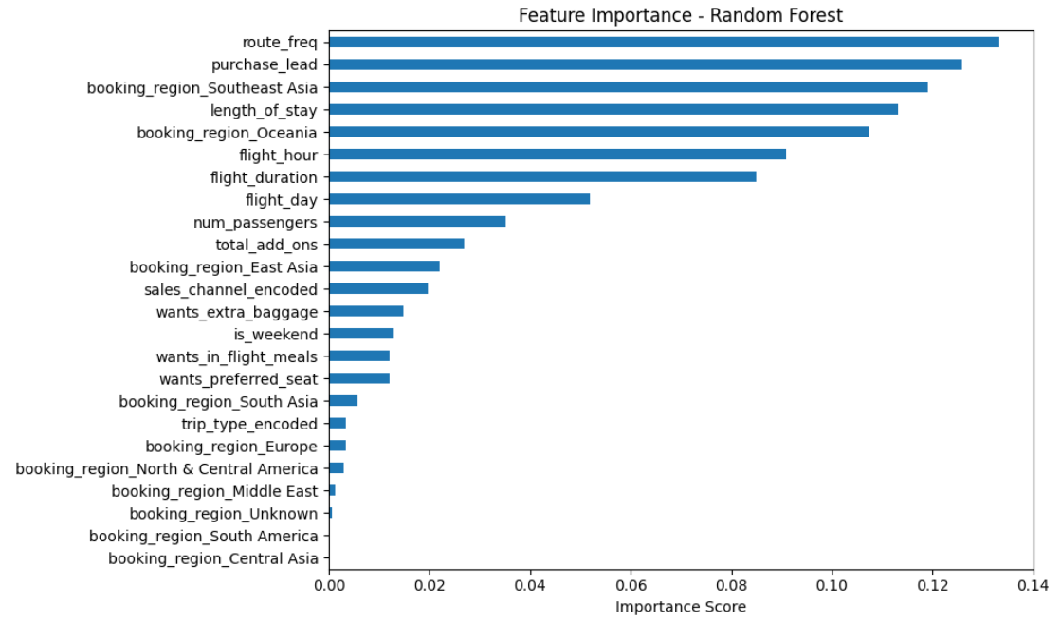
Predicting Customer Bookings - British Airways
We have trained the data set with Random Forest Classifier (n_estimators=200),Max depth: 15,Class weight: balanced,80/20 train/test split
Accuracy= 78.55 %
ROC-AUC= 77.23 %
Key Findings
Behavioral features dominate : route frequency is the strongest predictor which
tells busier route have more committed Bookers, purchase lead being the 2nd highest
indicator telling us the people who book earlier are more likely to complete their booking,
Length of stay also says about customer planning behavior.
Southeast Asia and Oceania are strong predictors, while Middle East,
South America and Central Asia have near-zero importance.
Model achieves 77.23% ROC-AUC, genuinely our model is useful model.
Moderate recall (52%) means we catch most real bookers
wants_extra_baggage, wants_in_flight_meals, wants_preferred_seat have low importance,
suggesting they don't reliably predict whether someone completes a booking

